Slide 1

XYZ Ads Airing Report Analysis
REPORT
CASE STUDY OF ADS

Slide 2

PROJECT DESCRIPTION:
Provided with dataset having different TV Airing Brands, their product, their category. Dataset includes the network through which Ads are airing, types of network like Cable/ Broadcast and the show name also on which Ads got aired. You can also see the data of Dayparts, Time zone and the time & date at which Ads got aired. IT also includes other data like Pod Position (the lesser the valuable), duration for which Ads aired on screen, Equivalent sales &, total amount spent on the Ads aired..

Slide 3
MY APPROACH:
The given data is already cleaned. I will create charts and graphs to meet the business requirement in Excel.
It is also observed that how the given variables are related to the case study and to

Slide 4

Tech-Stack Used:
We can use different tech tools for analysis of data , Here I use
MS-Excel
These sheets are used for cleaning and manipulating the data.
In this sheets we can perform different types of analysis
We can apply different formulas and functions.
In order to move further in the process , we use Excel
or Google sheets to answer the questions.
We can use Pivot Tables and can also insert Charts for Visualizations.
We can also use Statistical formulas and charts in the analysis.

Slide 5

PROJECT INSIGHTS:
1. What is Pod Position? Does the Pod position number affect the amount spent on Ads for a specific period of time by a company? (Explain in Details with examples from the dataset provided)
2. share of various brands in TV airings and how has it changed from Q1 to Q4 in 2021
3. competitive analysis for the brands and define advertisement strategy of different brands and how it differs across the brands.
4. P.S. Brownie points for any additional actionable insights draw from the dataset.

Slide 6
share of various brands in TV airings and how has it changed from Q1 to Q4 in 2021
competitive analysis for the brands and define advertisement strategy of different brands and how it differs across the brands.
P.S. Brownie points for any additional actionable insights draw from the dataset.

Slide 7
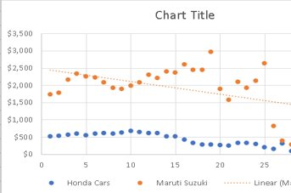
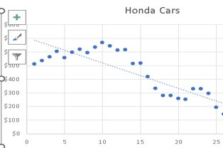
1.Pod Position Charts
An ad pod is a group of ads that are sequenced together to be played back-to-back within
a single ad break/placement, similar to ad breaks in traditional linear TV. Ad pods give publishers the opportunity to maximise revenue from each ad break and give advertisers more control over ad positioning.

Slide 8
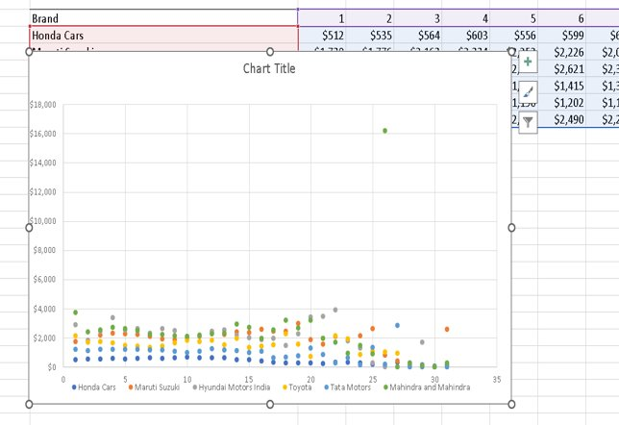
Pod Position Charts
90000
80000
70000
60000
50000
40000
30000
20000
10000
0
Gro

Slide 9
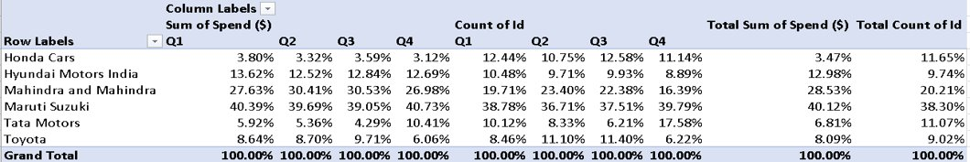
2.What is the share of various brands in TV airings and how has it changed from Q1 to Q4 in 2021?

Slide 10
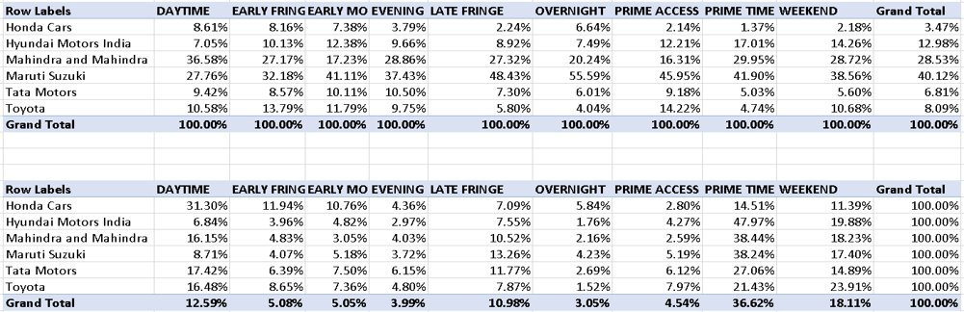
3. Conduct a competitive analysis for the brands and define advertisement strategy of different brands and how it differs across the brands.
Sum of percentage spent :

Slide 11
Finding and Strategy:
Honda Spends the maximum(32.88%) share of money for ads during the DAYTIME Dayparts and minimum share during PRIME ACCESS(2.23%) Dayparts while of all the spends done during DAYTIME, Honda accounts for only 8.61% of the Total.
Maruti Suzuki bears 55.59% of total spends done during OVERNIGHT Dayparts and it also has the maximum share for Number of Ads in the OVERNIGHT Dayparts(49.22%). This shows Maruti’s strategy for showing their ads.

Slide 12
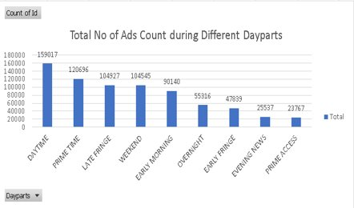
4. Mahindra and Mahindra wants to run a digital ad campaign to complement its existing TV ads in Q1 of 2022. Based on the data from 2021, suggest a media plan to the CMO of Mahindra and Mahindra. Which audience should they target? *Assume XYZ Ads has the ad viewership data and TV viewership for the people in India. P.S. Brownie points for any additional actionable insights you can draw from the dataset.
Mahindra & Mahindra should Target the Audience of DAYTIME and PRIMETIME viewers in the First Quarter of 2022. As observed from the Comparative Analysis Table Mahinda followed the same trend in 2021.

Slide 13

Results:
After Analysing all the data , I have drawn few insights from the analysis.
Pod position is a sequence of ads..
How is Ads Airing Analysis done.
Concept of Airing time, its significance.
Pod Position and it significance.
Excel visualization to understand Ads Airing Analysis.
Presented By:
Jayanth kumar

